Slide 1
The Clara Waldron Historical Room:
A Treasure Trove of Local Historical Resources
By Chuck Harpst,
Reference/Local History Librarian

Slide 2
Historical Room Mission Statement
Since its founding in 1974, the Tecumseh District Library’s Clara Waldron Historical Room has pledged itself to preserving and interpreting the unique history of Tecumseh and the Lenawee County area and encouraging community interest in local history to ensure that present and future generations can share in and understand their rich heritage.
(Adopted by the TDL’s Board of Trustees on November 15, 2006)

Slide 3
Historical Room History
In 1974, TDL created the first Clara Waldron Historical Room (CWHR), which was located in a small room in the basement. The room was named in honor of Clara M. Waldron, author of One Hundred Years a Country Town, a history of Tecumseh from 1824 to 1924.
The Historical Room moved to its current location in 2010.

Slide 4
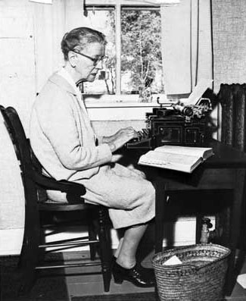
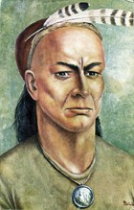
Clara Waldron
One Hundred Years A Country Town by Clara Waldron.

Slide 5
Scope of the Collection
The collection primarily includes material on the city of Tecumseh and the area covering the Tecumseh School District. Subjects include the history of the area’s settlement and growth, government, schools, churches, clubs, businesses, architecture, and individuals important to Tecumseh’s history and development.

Slide 6
Newspapers on Microfilm
TECUMSEH NEWS
1884-1894
1912
1914
TECUMSEH HERALD
October 1850 – December 1856 (plus the front page of March 5, 1857)
March 12, 1857 – November 11 1858
June 25, 1863 – November 8, 1866
November 19, 1874 – December 28, 1876
1878 – 1920
1922 to the present

Slide 7
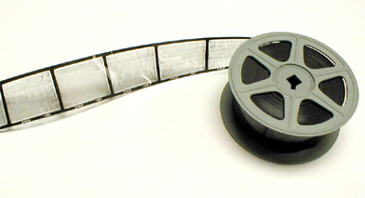
There are alphabetical indexes of births, marriages, and deaths for the Tecumseh Herald for 1850 – 2013.
The index notebooks are located on top of the filing cabinets next to the microfilm storage cabinets.

Slide 8
Atlas, Plat Maps & City Maps
Lenawee County atlases for the following years are available:
1874, 1893, 1916
Also on hand is a small collection of Lenawee County plat maps and Tecumseh city maps, including a Sanborn map of Tecumseh, Michigan, 1922.

Slide 9
Yearbooks
Junior High/Middle School paperback annuals dating back to 1970 are available. Senior High School hardcover and paperback yearbooks (called either “ANATH” or “SENIOR ECHOES”) dating back to 1919 are available. Editions from 1950 through the present are stored on the shelves. Older issues are storied in acid-free boxes.

Slide 10
Directories
Tecumseh: 1869, 1877, 1883, 1893, 1895, 1900, 1930, 1951
Lenawee County: 1897, 1915, 1916, 1927, 1940, 1953, 1968
State of Michigan Gazetteer of Business Directory, 1856

Slide 11
Scrapbooks and Ledgers Collection
Minutes of meetings, club program booklets, business records, ledgers, and scrapbooks from over 50 businesses, clubs and governmental units have been collected.
The archives include the Kiwanis Club of Tecumseh, the Little Garden Club, the Tecumseh Music Club, the Tecumseh Monday Club, the Wit & Wisdom Club, the Al Meyers Airport, and the extensive Perry Hayden diary and ledger collection.

Slide 12
Tax Assessment Rolls for the Village of Tecumseh
Tax rolls from the mid-1880s through the mid-1940s and a few ledgers of voter registrations are available for research. These collections are still in the process of preservation and organization.
Microfilm rolls of tax rolls for the following years are available for viewing: 1893, 1920, 1922, 1923, 1925, 1927, 1929.

Slide 13
Pamphlet Files
Fragile material such as newspaper clippings, brochures and pamphlets are stored in acid-free folders in file cabinets. Material is arranged by subject and filed in either the extensive Tecumseh Pamphlet File or the Michigan Pamphlet Files, which included materials about Lenawee County.

Slide 14
Newsletters
The newsletters of the Tecumseh Area Historical Society, the Lenawee Country Family Researchers and the Tecumseh Public School District have been collected and are archived. The current newsletters of the Tecumseh Area Historical Society and the Lenawee County Historical Society are displayed on the research tables.

Slide 15
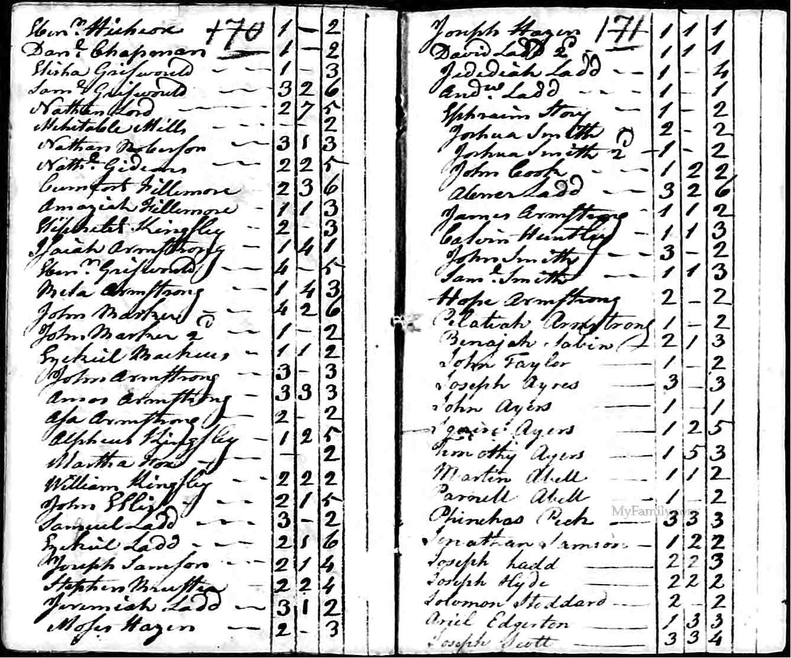
CENSUS MICROFILM ROLLS
Lenawee County: 1850 – 1930

Slide 16
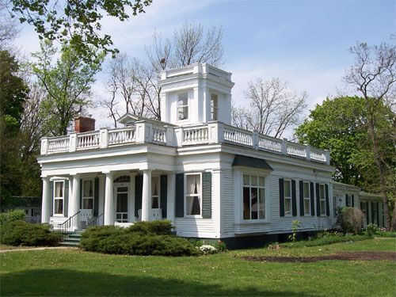
BLUEPRINTS
The architectural firm of MARR & MARR donated several blueprints and drawings for buildings that have been projects of the Herrick Foundation. These buildings are in the Lenawee County area.

Slide 17
Photographs and Slides
There are over 600 photographs of the Tecumseh area dating from 1860.
There is also a collection of color slides dating from the late 1950’s through the 1960’s taken by Tecumseh residents Joe Rice and Donald Berkley. Mr. Rice documented much of the construction going on in Tecumseh at that time. Through the use of memorial funds, the slide collections have been duplicated as prints for easier access to patrons and organized for better preservation of the original slides.

Slide 18
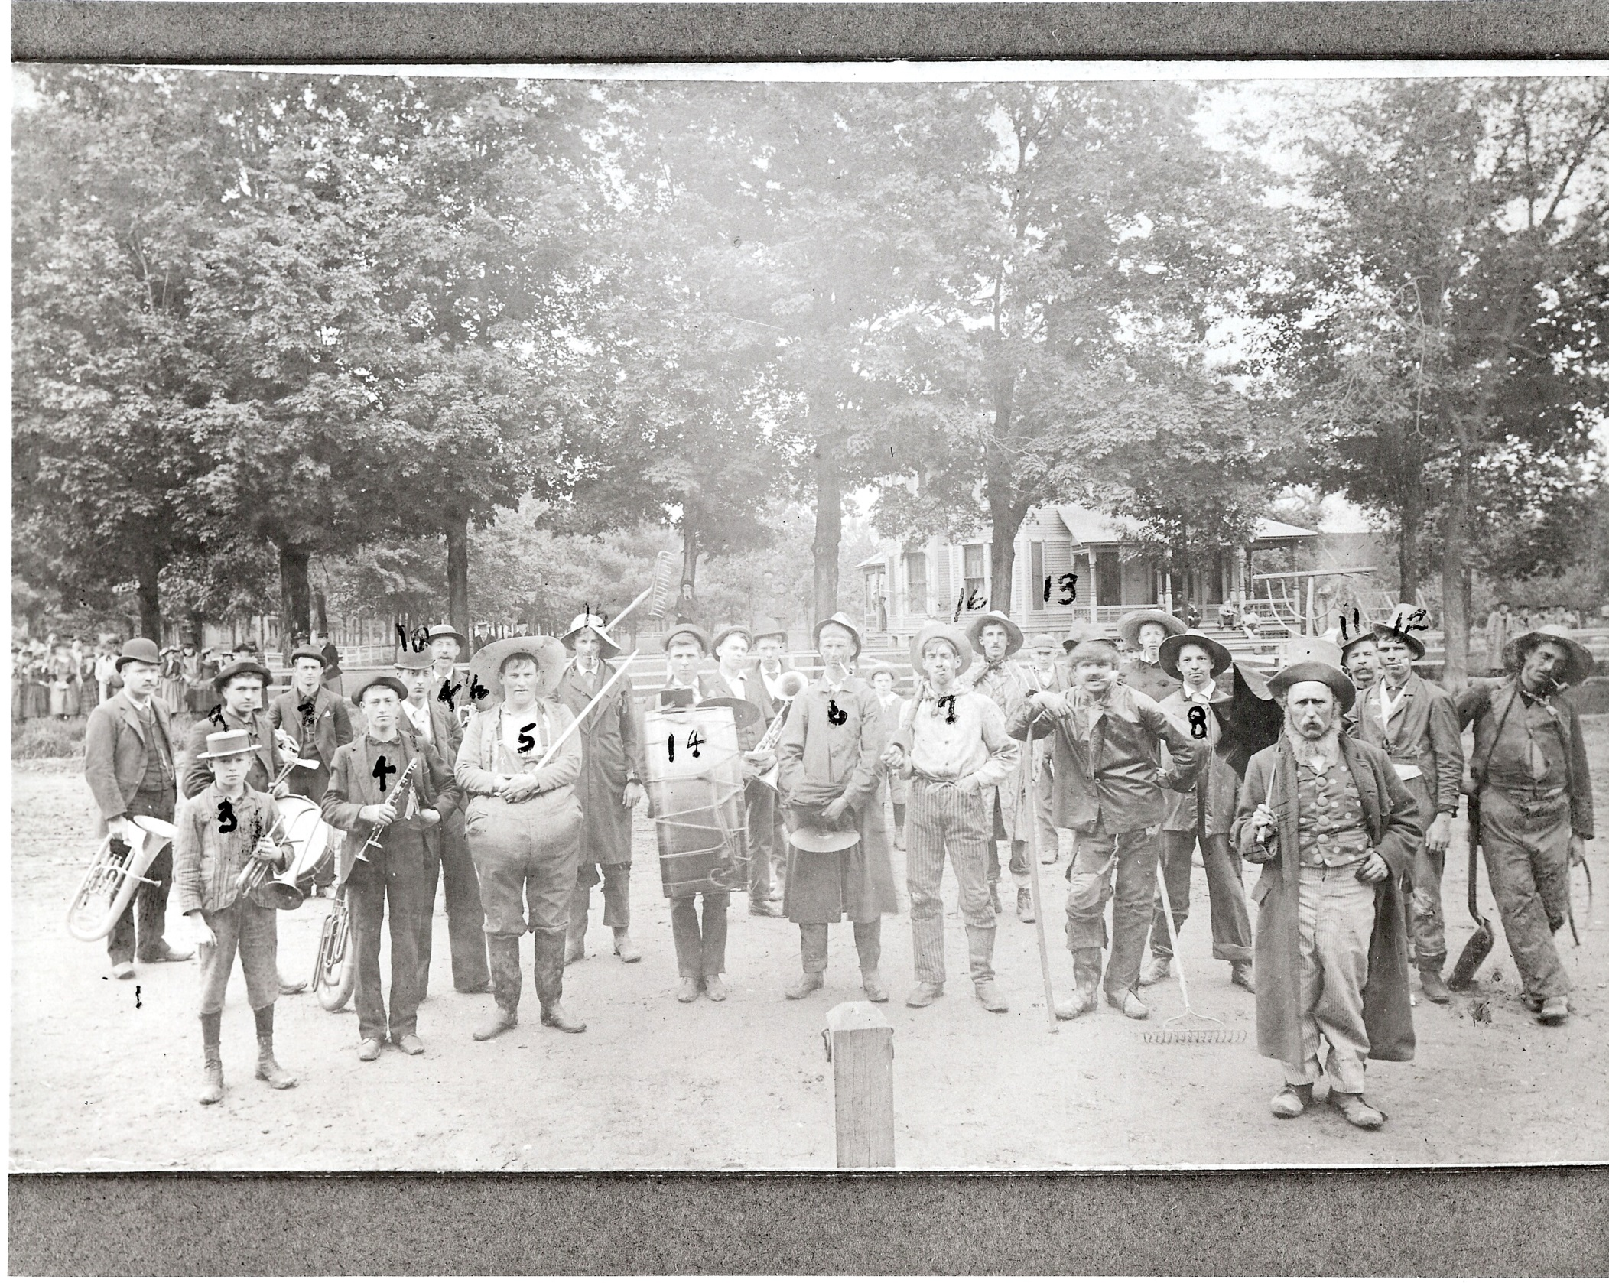
Notes:
“Hick-Clown” Band ca 1800’s. A Sports Day – 1st Block of East of R.R. – Shull Home is in background.

Slide 19
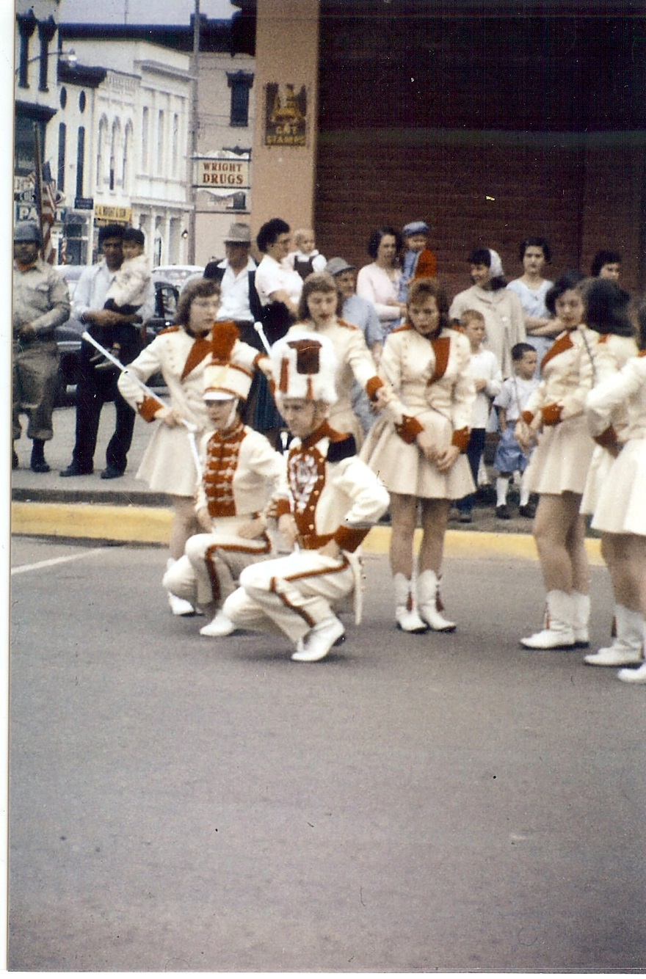

Slide 20
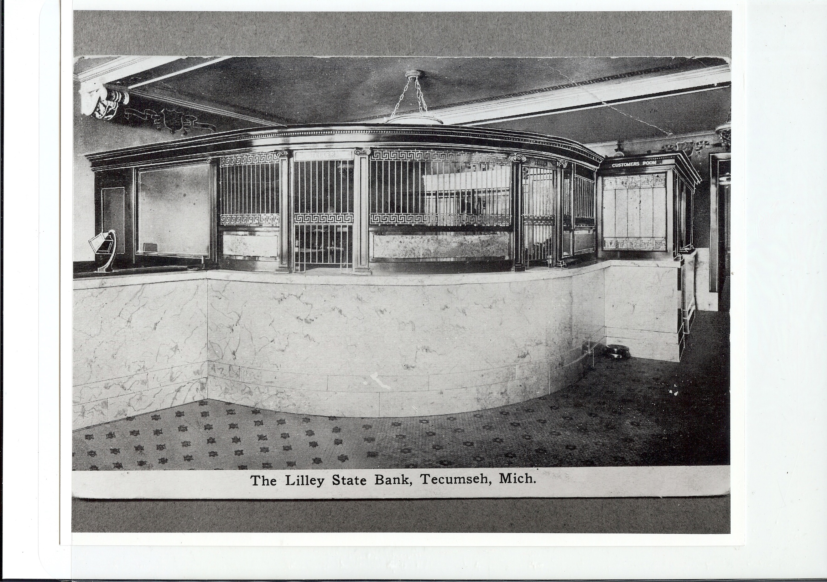

Slide 21
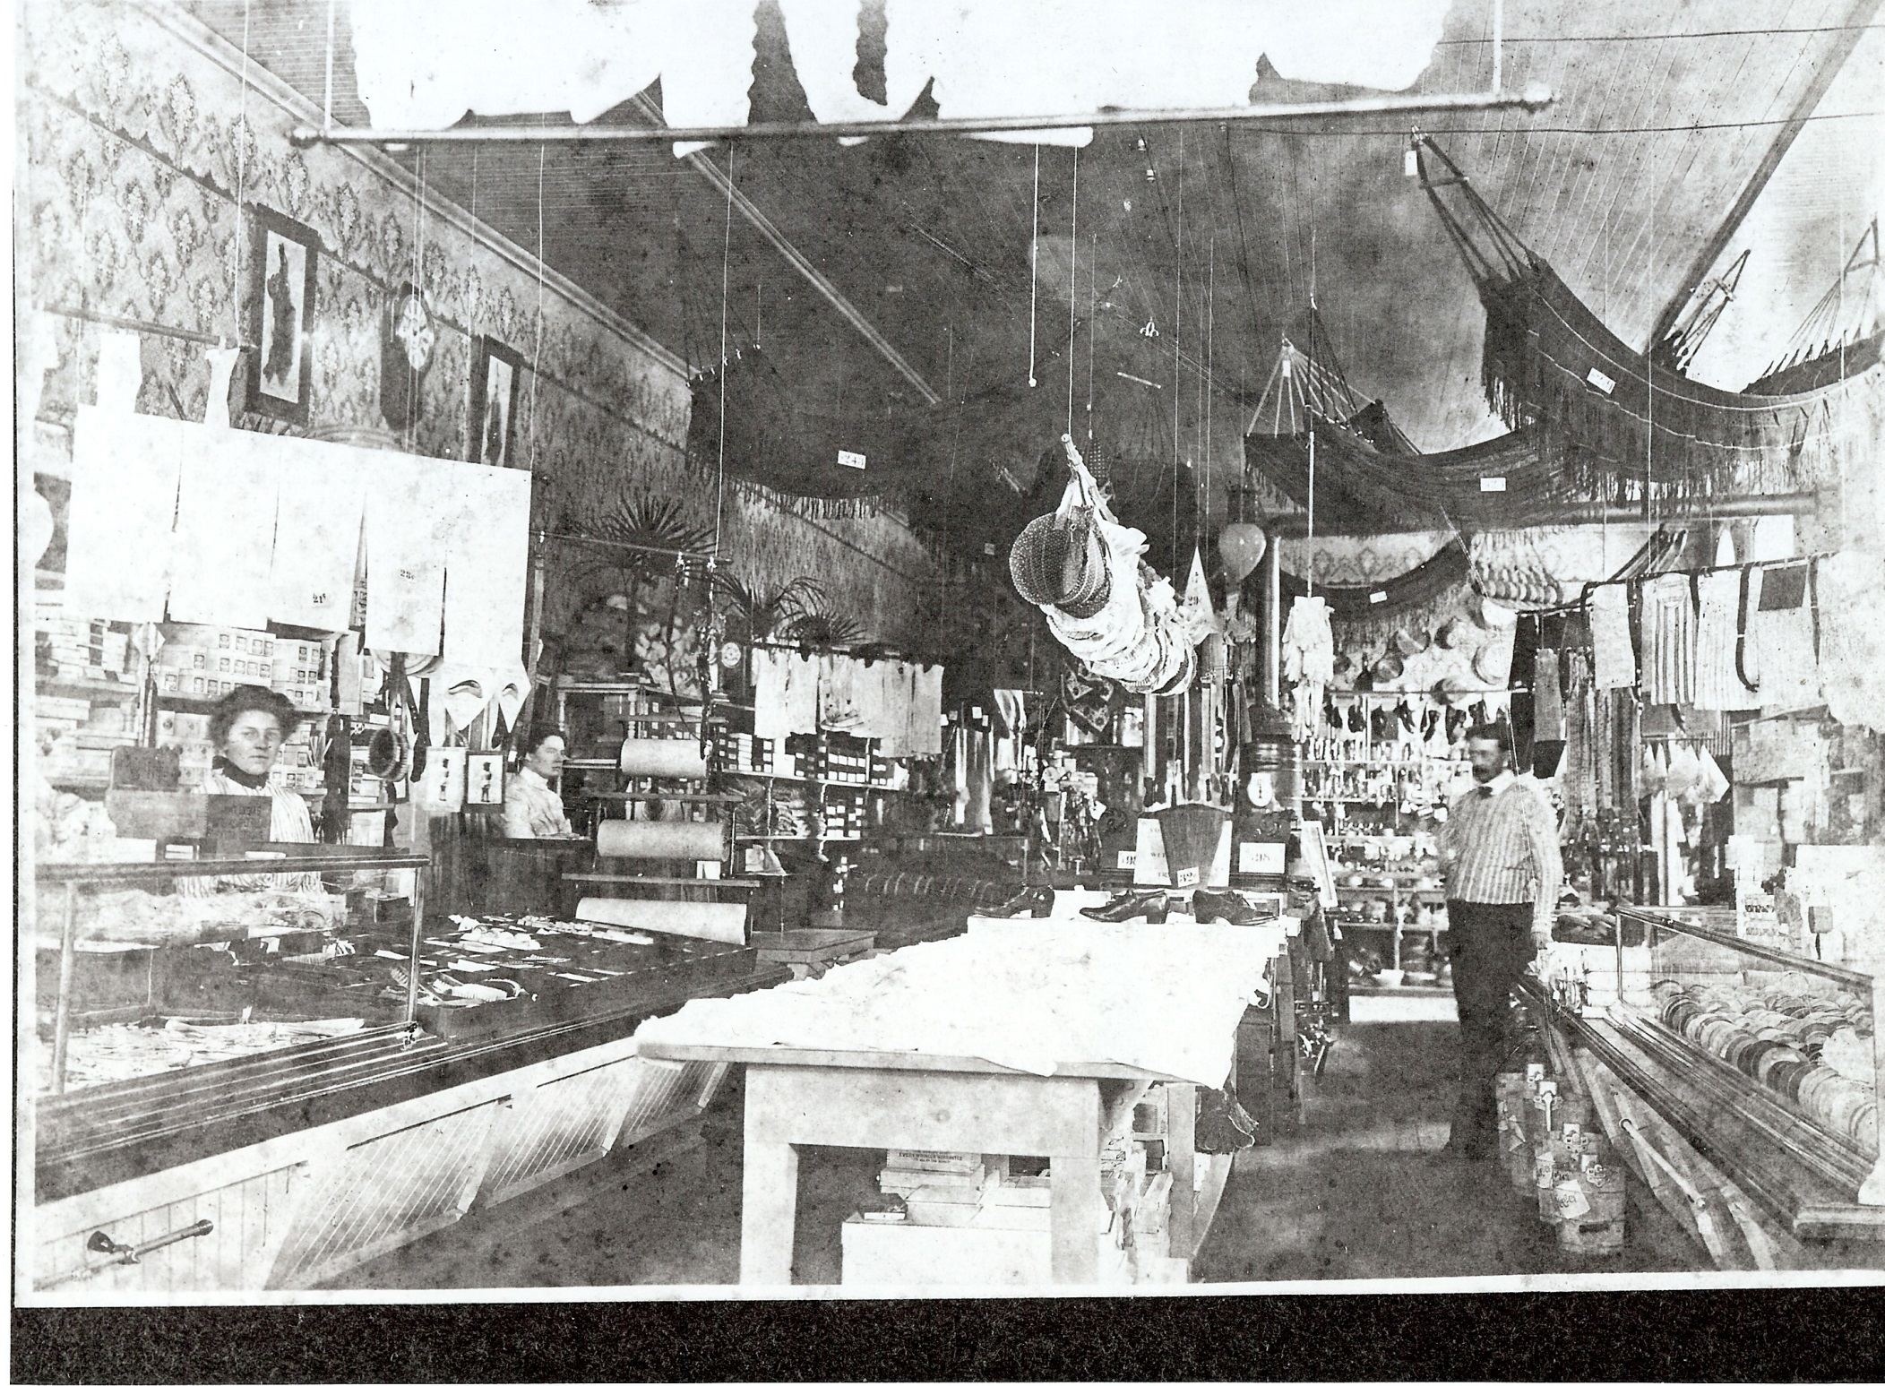

Slide 22
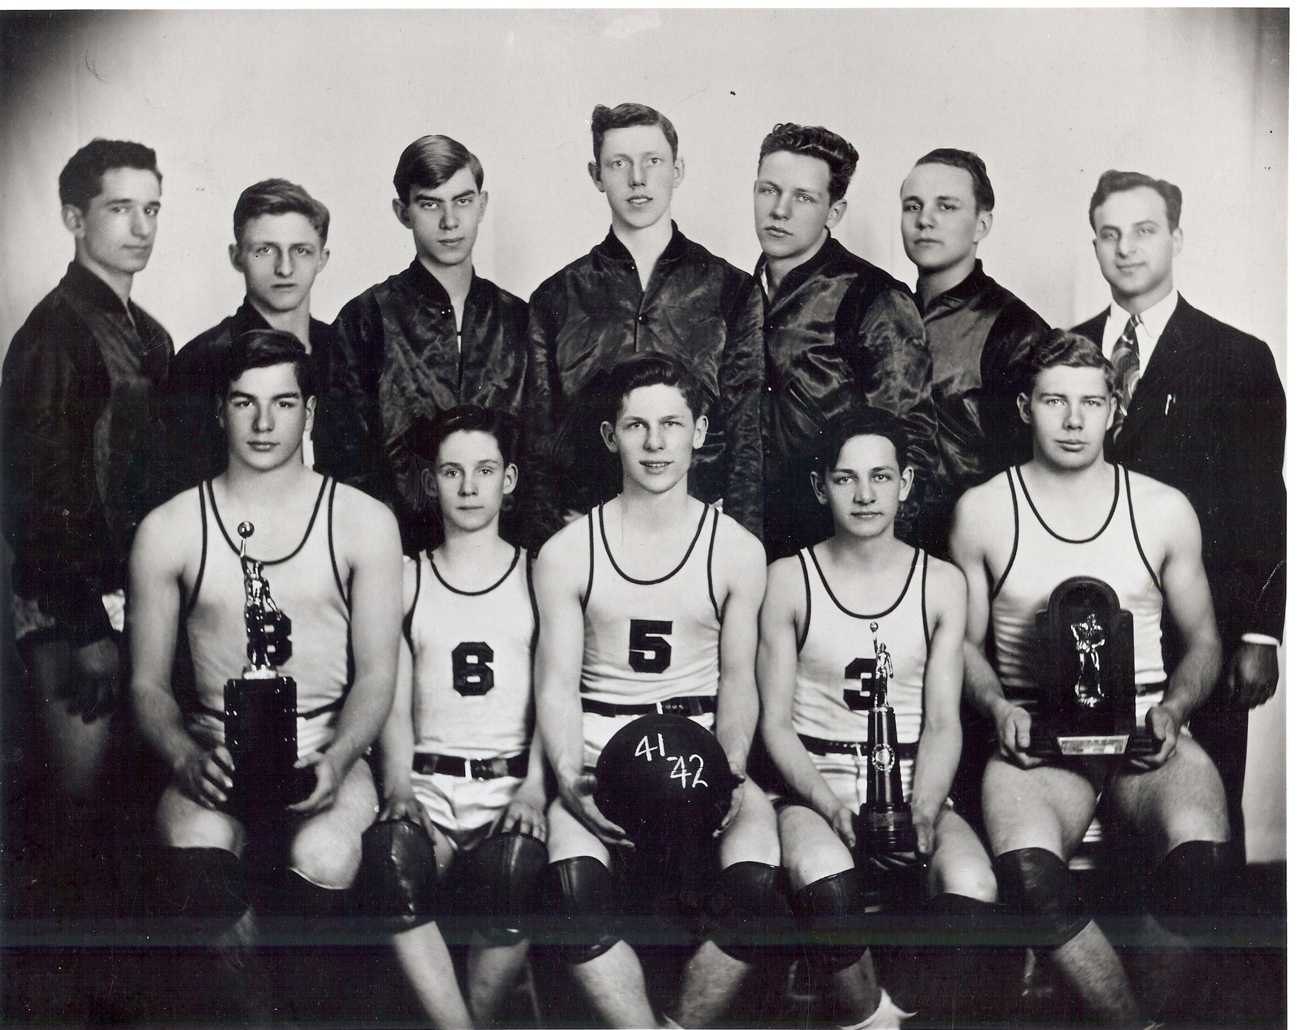

Slide 23
Films
Tecumseh resident Leon Rosacrans made seven black and white silent home movies of the Tecumseh area between 1927 and about 1950. Subjects featured include Henry Ford, Perry Hayden’s Dynamic Kernels project, Tecumseh Products Company, and the Irish Hills area of Lenawee County. These films have been transferred onto one videotape. The family of John Saling also donated a videotape of home movies depicting familiar Tecumseh scenes, events, and citizens, including the downtown area, sledding, Tecumseh Products Company staff, and Ray Herrick.

Slide 24
Oral History Videotapes
Tecumseh District Library produced a set of oral history videos that features twenty-eight interviews conducted by Mrs. Diane Proctor and videotaped by Mr. Harry Sabourin during the summer and fall of 1989. Lifelong residents and citizens instrumental in Tecumseh’s history shared their memories and commentaries. Participants included:
Donald Berkley, Elizabeth Kidman Boyce, Richard P. Boyd,Lillian Buttolph, William Chase, Harriet Colyer (relative of Clara Waldron), Fred Dickinson, Merlyn Downing, Bernice Duncan, Dr. Richard Dustin, Harold Easton, George Elliott, Bob Gerweck, Albert Hammond, Sue Hoot, George Kempf, Barb Kruger, Wallace MacGeorge, Charles Manley, Albert Merz, Frances Pennington, William Powell, Olis Puffer, Frances Rathbun, Ned Rosacrans, Magdalena Saling, E. L. “Speck” Simmons and Nellie Wilson.

Slide 25
More Videotape Details
The videotapes give viewers an “up close and personal” account of Tecumseh’s development. Subject areas discussed include: education, medicine, city government and services, Tecumseh Products, churches, Clara Waldron, downtown businesses, neighborhoods, local organization and clubs, banks, the military, the Depression, the Tipton community, family life and women’s roles. The length of the tapes varies from 30 minutes to 1 1/2 hours.

Slide 26
Books
There is a small collection of standard histories of the Tecumseh area and Lenawee County. Other useful multi-volume resources include the Michigan Pioneer Society, the Germans to America Series II: List of Passengers Arriving at U.S. Ports in the 1840s, the Genealogical Abstracts of Revolutionary War Pension Files, the Record of Service of Michigan Volunteers in the Civil War, and the Names of Soldiers Who Died in Defense of the American Union, interred in the National Cemeteries, accompanied by the Index to the Roll of Honor.

Slide 27
Handling Materials and Photocopying
Materials in the CWHR are often fragile. Please handle all items carefully and observe the following guidelines:
Turn pages of books carefully.
Close books when not in use. Leaving them open or open face down damages the spine.
Do not write in or on any material.
Do not turn down corners of pages.
Handle photographs by the edges only.
Do not remove photographs from the plastic Mylar sleeves.
Leave photographs face down on top of the file cabinet when you are done.

Slide 28
More Photocopying Guidelines
Nothing in the CWHR collection may be photocopied without permission from the library staff. The heat and light from the photocopier accelerate the aging process of materials. In order to preserve the valuable items contained in the collection, permission to photocopy will be given at the library staff’s discretion. Original photographs may be copied by camera only, never by the photocopier.

Slide 29
Questions

